Slide 1
Reading Rubrics to Understand What is Expected
Self Advocacy Letter Rubric for Assessment

Slide 2
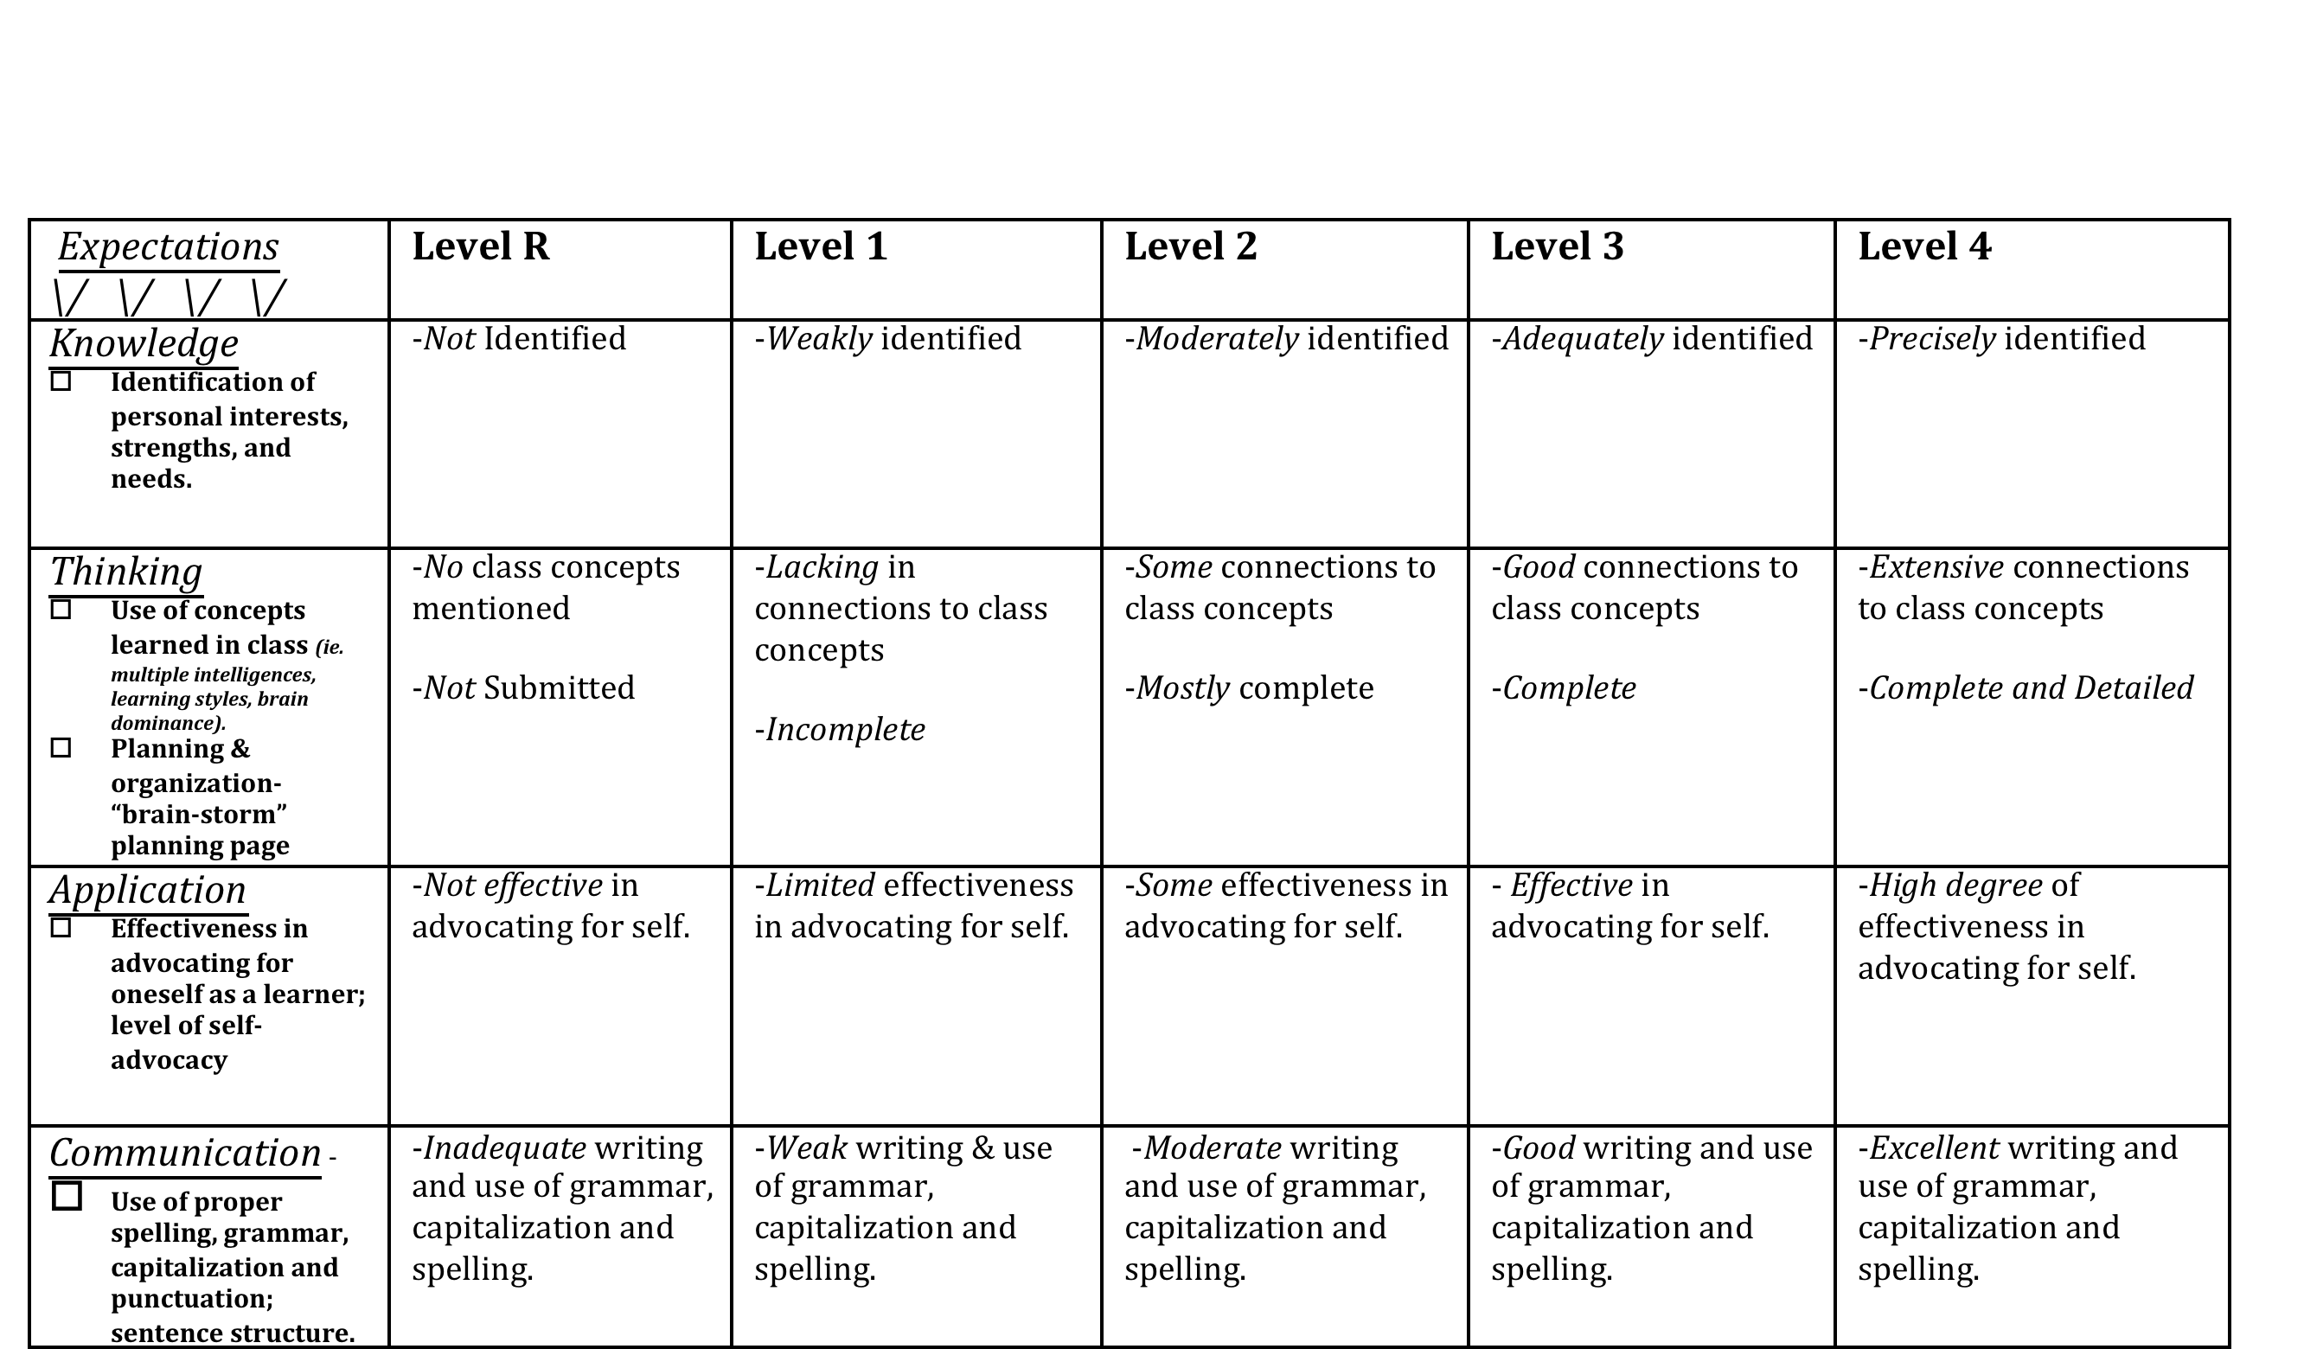
Self Advocacy Letter –
Rubric for Assessment

Slide 3
Expectations
Knowledge Identification of personal interests, strengths, and needs.
Thinking Use of concepts learned in class (ie. multiple intelligences, learning styles, brain dominance). Planning & organization- “brain-storm” planning page
Application Effectiveness in advocating for oneself as a learner; level of self-advocacy
Communication - Use of proper spelling, grammar, capitalization and punctuation; sentence structure.

Slide 4
Knowledge

Slide 5
Thinking

Slide 6
Application

Slide 7
Communication

