Slide 1
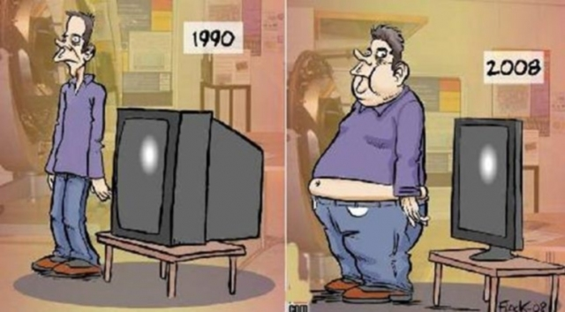
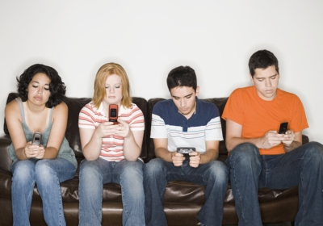
Chapter 4
Growing Trends in Canadian Society

Slide 2
Read pp. 124-125 before lesson
Technology in Schools

Slide 3
Technology in Schools
Many schools have embraced the use to the newest technology in the classroom
Teachers use technology to modernize their teaching practices
Technology can be distracting, though!
Divide in student attention

Slide 4
Using Technology Wisely
“Use of Technology Agreements”
Used so parents and students understand what is considered appropriate
Outlines that the use to technology is for the enhancement of learning only → any abuse will result in the loss of privileges
But, it’s still an issue
Students use technology to socialize during class

Slide 5
Discussion: Tech Distraction
Is texting a major distraction?
Does it take you away from your work?
mentally? Physically?
Does it take away from your face-to-face social time?

Slide 6
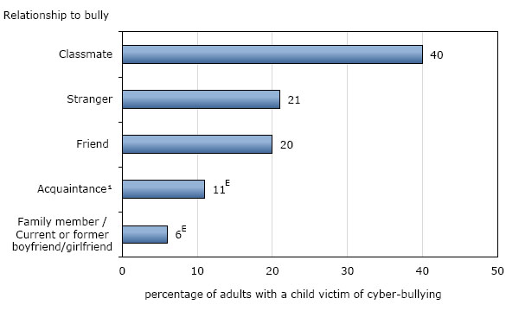
Other Problems…
Cheating
Privacy issues ← some schools monitor student’s online history
Bullying

Slide 7
Primary Research Applications: Technology in the Classroom
What questions might be considered if you were to complete a survey to find out how much time students spend off-task, as a result of using technology while completing school work?
Discuss with your elbow partner some sample questions, then share with the class.

Slide 8
Technology & Adolescent Development
Read article handout and complete the following questions in your notes: http://harvardmagazine.com/2013/11/is-there-an-app-for-that
Explain how Erikson’s theory applies to this topic.
Summarize how “apps” have changed adolescent development and experiences.
What is/are the author’s main argument(s)?
When finished – Read pp. 126-130 & answer questions 1, 2 & 3
→ HOMEWORK IF NOT COMPLETED IN CLASS.

